Slide 1
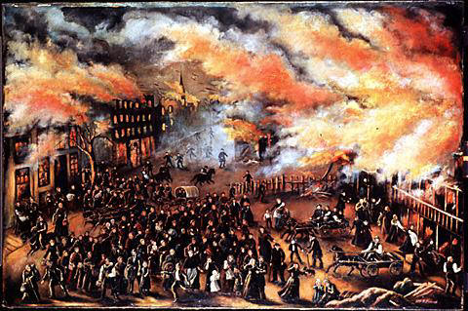
The Great Chicago Fire of 1871
Cheryl Valek
Adapted from:Paul L. Horance
Notes:
Picture from: <http://images.google.com/imgres?imgurl=http://www.indcjournal.com/archives/great%2520chicago%2520fire.jpg&imgrefurl=http://www.indcjournal.com/archives/2004_12.php&h=319&w=480&sz=62&tbnid=H04M2nTX3zW7dM:&tbnh=83&tbnw=126&hl=en&start=1&prev=/images%3Fq%3DThe%2BGreat%2BChicago%2BFire%26svnum%3D10%26hl%3Den%26lr%3D>
All quotes are from www.chicagoohs.org unless otherwise marked.

Slide 2
ESSENTIAL QUESTION
How did the Great Chicago Fire of 1871 lead to Chicago becoming a great American city?

Slide 3
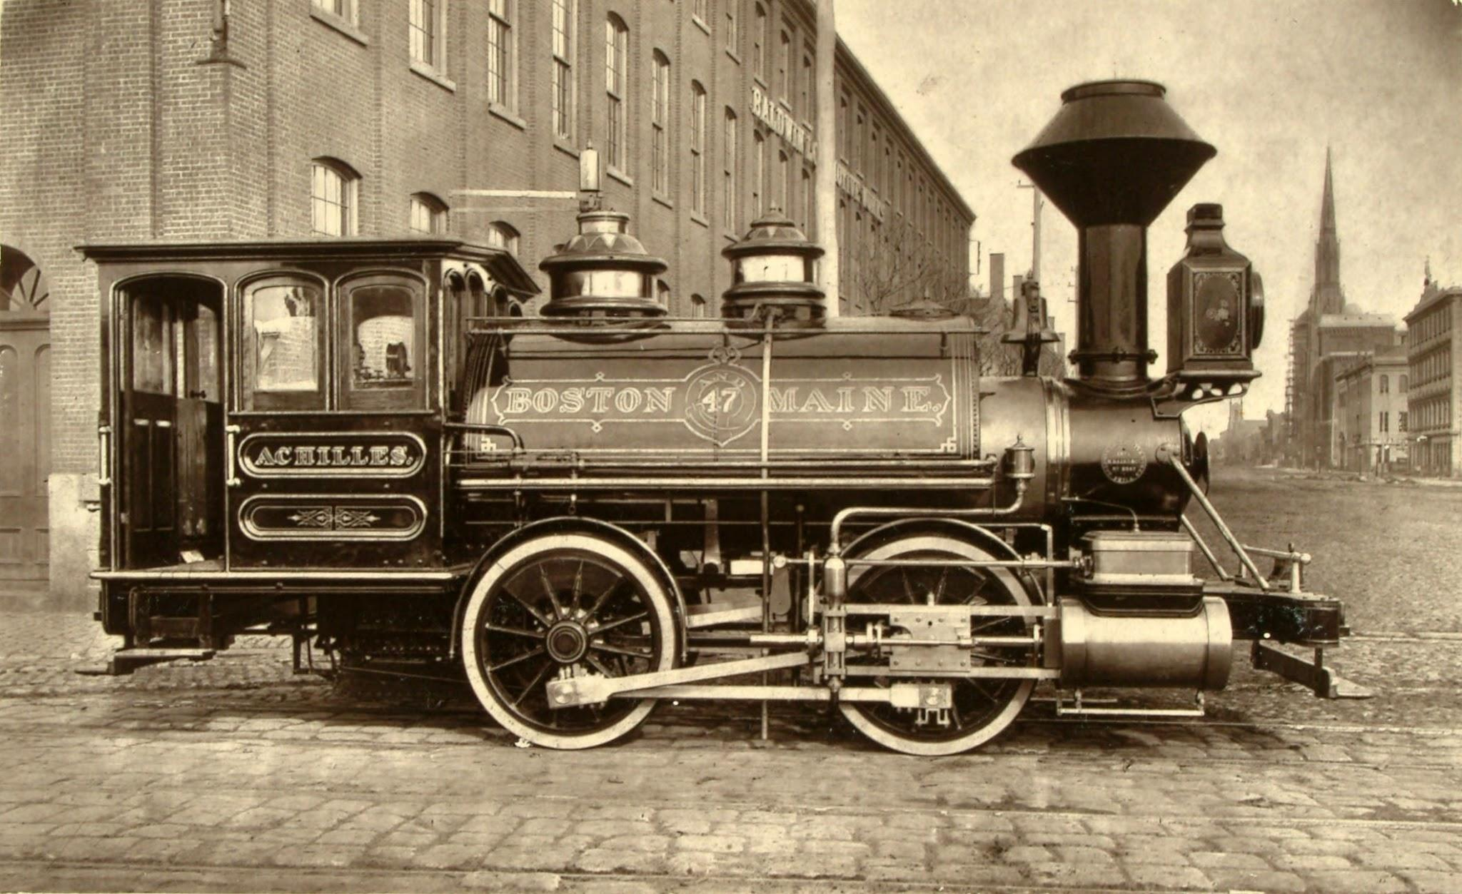
Background
Brief History of Chicago:
Chicago became a major railroad hub in the mid to late 1800’s because the city connected the East with the West.
Chicago had begun to grow at a great rate during and after the Civil War.
Notes:
Picture from: <http://images.google.com/imgres?imgurl=http://www.ci.austin.tx.us/library/ahc/images/train01_pica18441.jpg&imgrefurl=http://www.ci.austin.tx.us/library/ahc/train01.htm&h=252&w=305&sz=21&tbnid=JbdbssXSOp6CSM:&tbnh=92&tbnw=112&hl=en&start=15&prev=/images%3Fq%3Dtrain%2B1871%26svnum%3D10%26hl%3Den%26lr%3D>

Slide 4
Background
Leading up to the Great Chicago Fire:
Chicago had already had a few large fires in 1839, 1849, and 1857.
October of 1871 had been warmer and dryer than past Chicago October’s.
The year of the fire, the entire city of Chicago only had 185 fire fighters.
Notes:
The fact that Chicago had so few fire fighters didn’t seem to worry anyone at the time.
The idea of fire safety was not yet a major issue in Chicago or in other American cities for that matter.

Slide 5
Background
Chicago right before the fire:
Chicago fire fighters had been complaining to the city that their equipment was inadequate and that they didn’t have enough men.
Many of these fire fighters were tired from fighting a large fire October 7th (the day before the Great Fire) that had demolished four blocks of the city.
The city of Chicago had experienced 20 small fires in the week before the Great Fire.
Notes:
The fact that fire fighters had been complaining for more adequate equipment leads many to wonder if the Great Chicago fire could have been prevented.
It seems incredible to us today that a city could have 20 fires in a week and still not worry about the possibility of a larger fire.
Technology played a role in Chicago not being prepared for the fire. Perhaps if news had spread about the many other fires, the Great Fire could have been prevented.

Slide 6
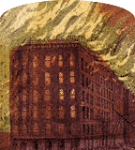
The Great Chicago Fire
The fire begins:
The fire began on October 8th, 1871 between about 8:30 and 10:00pm.
A combination of miscommunication and inadequate technology caused problems from the beginning of the fire.
Notes:
Needless to say, when the fire began, no one could have believed it would turn out to be so devastating.
In the crucial first minutes after the fire began, if a number of small things (that I will discuss later in the powerpoint) hadn’t gone wrong, the fire probably could have been stopped.

Slide 7
The Great Chicago Fire
The fire began to spread quickly as it reached the Chicago River which was filled with oil and debris from nearby factories.
Hard blowing winds from the southwest forced the fire towards the north and northeast parts of the city.
In the first few hours of October 9th, the fire devastated a lower-class Irish neighborhood known as Conley’s Patch.
At day break, as the fire continued to spread north, more and more buildings were consumed.
“In less than ten minutes the fire embraced the area between Jefferson and Clinton for two blocks north, and rapidly pushed eastward to Canal Street..”
-Chicago Tribune, October 10, 1871
Dewitt Cregier, later the mayor of Chicago, described the inferno as “a sea of fire.” 0

Slide 8
The Great Chicago Fire
The fire continued north consuming, or at least damaging, almost every building in its path.
Many people by this point were completely exhausted from running, often with personal items, from place to place.
Finally, on the night of October 9th, rain began to fall on Chicago.
Before October 9th had ended, the fire was under control.
“There was no sleep for us until we heard the welcome sound of rain against our windows. How our hearts did rise in thankfulness to heaven for rain!”
-Horace White (editor-in-chief, Chicago Tribune)
Notes:
Even after the fire was under control, there was still a lot the city had to deal with.
For one, because the city was still very hot, some people could not return to their homes.
Also, the people of the city were in complete shock and many needed to be attended to before the real cleanup of the city could begin.

Slide 9
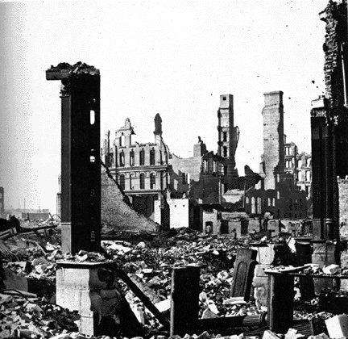
Facts about the Fire
The Aftermath:
Many important buildings, such as the City Courthouse, burned down.
The fire burned 3½ square miles of the city.
Around 17,500 buildings were damaged or burned to the ground.
More than 70 miles of streets were burned

Slide 10
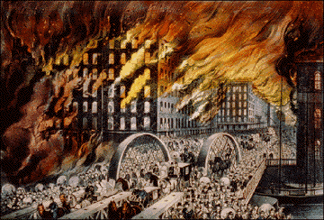
Facts about the Fire
The fire caused an estimated $200 million of damage.
About 100,000 people were left homeless.
Although the exact number of deaths is unknown, the death toll is estimated to be between 120-300 people.
Notes:
Picture from: <http://images.google.com/imgres?imgurl=http://www.superchefblog.com/images/chicagofire_360x244.png&imgrefurl=http://superchefblog.com/2005/11/foie-gras-war-voodoo-and-vigilantes.html&h=244&w=360&sz=51&tbnid=KnSH2FTioEJaDM:&tbnh=79&tbnw=117&hl=en&start=18&prev=/images%3Fq%3DThe%2BGreat%2BChicago%2BFire%26svnum%3D10%26hl%3Den%26lr%3D>

Slide 11
Why was the Great Chicago Fire
So Bad?
The Great Chicago Fire was a disaster for many reasons. In the response to the fire, many things were working against the city of Chicago:
A watchman who first saw the fire, mistakenly told the telegraph dispatcher the wrong streets at which the fire began.
When the error was recognized, the dispatcher didn’t change the message he had received from the watchman.
Notes:
It is possible that if either of these two errors hadn’t occurred, the fire could have been controlled.

Slide 12
Why was the Great Chicago Fire
So Bad?
Also adding to the problem was a faulty fire-alarm box. The city of Chicago had installed the boxes so that people could immediately inform fire fighters of a fire. Unfortunately, the fire-alarm wouldn’t activate.
When the fire fighters did reach the fire, they were so tired from fighting the night before they were unable to get a good jump on the fire.
Notes:
Again, one can only wonder how the fire may have turned out were it not for these issues compounding the initial problem.

Slide 13
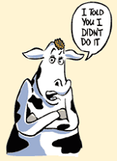
The Great Chicago Fire- Myths vs. Facts
The most widely known explanation of how the Great Chicago Fire began is the story of the O'Leary cow. The story says that the fire began when a cow owned by Mr. and Mrs. O’Leary kicked over a lantern in the O’Leary barn. Many believed this explanation because the fire did start in the barn behind the O’Leary house. However, this story is not true and in 1997 the city of Chicago denounced it as myth.
“One dark night, when people were in bed,
Mrs. O’ Leary lit a lantern in her shed,
The cow kicked it over, winked its eye, and said,
There’ll be a hot time in the old town tonight” -Unknown
Notes:
Picture from: <http://images.google.com/imgres?imgurl=http://jocofd1.org/Graphics/CowTale.gif&imgrefurl=http://jocofd1.org/firepreventionweek/fireprevweek.htm&h=198&w=144&sz=10&tbnid=Ow5ia9Dsl5AdGM:&tbnh=99&tbnw=72&hl=en&start=6&prev=/images%3Fq%3DThe%2BGreat%2BChicago%2BFire%26svnum%3D10%26hl%3Den%26lr%3D>

Slide 14
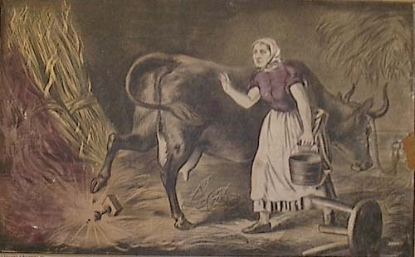
The Great Chicago Fire- Myths vs. Facts
The Truth:
Although the city talked with a large number of Chicago residents and took extensive notes on everyone’s explanations, it was never established who started the fire. Those involved in the investigation concluded, “whether it originated from a spark blown from a chimney on that windy night, or was set on fire by human agency, we are unable to determine.”
Notes:
Picture from: http://www.thechicagofire.com/oleary.php

Slide 15
What Was the City of Chicago’s Initial Reaction and Response?
Chicagoans initial response to the fire was incredible. Many Chicago citizens worked day and night to get the city back up in running. With help and money pouring in from other American cities, Chicago was able to build 6,000 makeshift buildings for the homeless within about a week.
Notes:
Chicago received help from outside of America as well.
Many people gave books (about 7,000 texts) to the Chicago library in an attempt to help build the city back up.

Slide 16
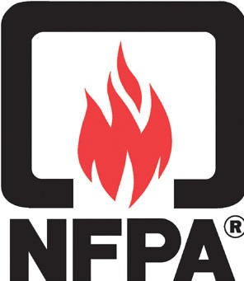
What Was the City of Chicago’s Initial Reaction and Response?
Prevention:
The first thing the fire did was unite the city around a common cause. For the first time, a large number of people began arguing for better fire codes, fire precautions, and fire equipment for firemen. It was clear that no one wanted to go through another Great Chicago Fire.
National Fire Protection Association
Notes:
Every year, America has a fire prevention week.
This week is always in early October to commemorate the Great Chicago Fire.
Picture from: <http://www.seguridadydefensa.com/images/links/nfpa.jpg>

Slide 17
Physical Changes After the Fire
Soon, Chicago’s streets were changed. Because Chicago had originally been built upon wet land, many of the early roads were made of wood. At the time, wood seemed like the smartest material to use to keep the city above the wet terrain. However, after the Great Fire, roads were no longer created of wood due to their flammable nature.

Slide 18
Structural Changes After the Fire
The fire played a major role in changing the building materials of houses. After the Great Fire, people realized that nonflammable materials were needed for building homes and businesses. Soon many more buildings were created of brick rather than wood. The idea of using brick and other less flammable materials soon spread throughout America.

Slide 19
Social Changes
Unfortunately for the poor, the city did little to stop the rumors. The city’s officials were glad to have someone blamed for the fire. The city officials realized that they could have just as easily been blamed due to the city’s lack of firemen and other supplies.
The fire in many ways actually widened the gap between rich and poor.

Slide 20
Social Changes
The social classes separated more and more in large reason because of money.
While the rich were able to rebuild with bricks and other nonflammable material, the poor were unable to afford these more expensive building materials.
Many of the poor didn’t have fire insurance before the fire which left them completely vulnerable after the fire.

Slide 21
An Optimistic Response
“From the Ruins Our City Shall Rise!” a song by George Frederick Root:
Dreary, dreary, the darkness falls,
While the autumn winds moan
through blackened walls.
But see! The bright rift in the cloud
and hear the great voice from the shore!
Our city shall rise!
Yes, she shall rise!
Queen of the west once more!
Notes:
Song lyrics from The Great Fire Chicago 1871 (p. 202). I am unsure whether or not the book emphasizes by italicizing or if the italics were originally there.

Slide 22
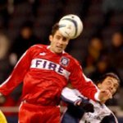
Lasting Effects of the
Great Chicago Fire
The Great Chicago Fire has had some lasting effects on America:
Fire Prevention Week (This year it is between October 8th and October 14^{th.}
The fire inspired the name of a Major League Soccer (MLS) team based in Chicago:
--The Chicago Fire.
Notes:
2006 will be the 110 year anniversary of the founding of the NFPA (National Fire Protection Association)
Also of note is that a movie was created in 1937 about the fire titled In Old Chicago.

